Slide 1

Disaster Damage Identification in Social Media Posts
DATS 6501 – Data Science Capstone
Yuan Meng

Slide 2

Table of Contents
Introduction
Literature Review
Methodology
Results & Analysis
Conclusion
References
Notes:
1. Introduction
a. Background
b. Problem Statement
c. Problem Elaboration
d. Motivation
e. Project Scope
2. Literature Review
a. Relevant Research
3. Methodology
a. Dataset Description
b. Data Collection
c. Data Preprocessing
d. Data Modeling & Visualizations
4. Results & Analysis
5. Conclusion
6. References

Slide 3
1. Introduction-Background
Recently worldwide disasters (Woodall, 2021)
Cyclone Kompasu (Maring)
Philippines, Oct. 12
19 people died, 13 missing
Flooding
China, since early October
India, dozens of people died
Earthquake
Greece, Oct. 12, 6.3 magnitude
Indonesia, 3 people died
Social media contents:
vital information sources
Hurricane Sandy (Baer, 2012)
25 first aid personnel
2.5 million posts
Hurricane Harvey (Rhodan, 2017)
rescue a woman tweeting for help
911 not responding
Notes:
Center for Disaster Philanthropy (CDP)
Reports of injured people, infrastructure damage, and missing people
References 1-3

Slide 4
1. Introduction-Problem Statement
The rescue staffing cannot deal with all the dangers immediately when major disasters occur, so it is necessary to grade the situation according to the urgency. This project aims to build a convolutional neural network model to identify the pictures with disaster types and the degree of urgency to help rescuers arrange rescues reasonably.

Slide 5
1. Introduction-Problem Elaborationt
How does the model work?
How can the model work for social media posts?
Notes:
The more serious the disaster in the picture, the higher the emergency degree of rescue. The collected data has marked disaster categories and severity, and the model uses these as labels for training. The CNN model first identifies the type of disaster and then the urgency (degree of disaster).
The model can be used for social media posted images with disasters tags. For example, when a city faces a flood, hundreds of rescue messages with flood photos may appear on social media within one minute. However, rescuers cannot go to these locations simultaneously. With this model for urgency classification, rescuers can prioritize those areas that have been severely affected and reduce casualties.

Slide 6
1. Introduction-Motivation
Personal experience
Since 17 July 2021, Zhengzhou China
Maximum rainfall of 201.9 millimetres (7.95 in) in an hour
Water and power outages
Busy helpline
Thousands of help posts on Weibo
Notes:
References 4

Slide 7
1. Introduction-Project Scope
Result Organization
Tweets Gathering
Image classification
Natural Language Processing
Relevant Tags
Target disaster
Degree of urgency
Key information
Rescue arrangement

Slide 8
2. Literature Review
Firoj Alam, Ferda Ofli, and Muhammad Imran, CrisisMMD: Multimodal Twitter Datasets from Natural Disasters. In Proceedings of the 12th International AAAI Conference on Web and Social Media (ICWSM), 2018, Stanford, California, USA.
Hussein Mozannar, Yara Rizk, and Mariette Awad, Damage Identification in Social Media Posts using Multimodal Deep Learning, In Proc. of ISCRAM, May 2018, pp. 529–543.
Ferda Ofli, Firoj Alam, and Muhammad Imran, Analysis of Social Media Data using Multimodal Deep Learning for Disaster Response, In Proceedings of the 17th International Conference on Information Systems for Crisis Response and Management (ISCRAM), 2020, USA.
Notes:
The first study indicates extensive research uses social media textual content but little focuses on images shared on social media due to the lack of labeled imagery data. To solve the issue, it introduces CrisisMMD datasets with three types of annotations: informativeness, humanitarian categories, and damage severity categories. The research also proves the dataset can fulfill several humanitarian use cases and tasks.
The second research informs that an automated system that detects and flags social media posts for disaster and crisis data is essential to efficiently direct relief resources because monitoring social media content becomes common among emergency responders. And it focuses on the second part of the automated systems, identifying infrastructure and environmental damage elements in posts.
The third study uses multimodal deep learning techniques to analyze the social media data for disaster response. It uses both text and image modalities of Twitter data to learn informative and humanitarian tasks, such as if a tweet contains informative content or shows affected individuals or infrastructure damage.
References 5-7

Slide 9
3. Methodology-Dataset Description
Disaster types
Other disaster
Earthquake
Fire
Flood
Hurricane
Landslide
Not disaster
Test: 3195
Length
Train: 12846
Validation: 1470
Test: 3865
Damage severity
Little or none
Mild
Severe
Length
Train: 28319
Validation: 2712
Crisis image benchmark dataset
Damage severity
Disaster types
Informativeness
Humanitarian categories
Notes:
References 8

Slide 10

3. Methodology-Dataset Collection
import os
if "crisis_vision_benchmarks" not in os.listdir():
os.system("wget https://crisisnlp.qcri.org/data/crisis_image_datasets_benchmarks/crisis_vision_benchmarks.tar.gz")
os.system("tar xf crisis_vision_benchmarks.tar.gz")

Slide 11
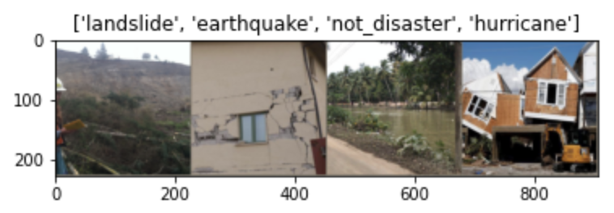
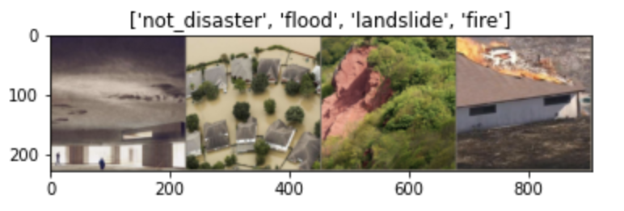
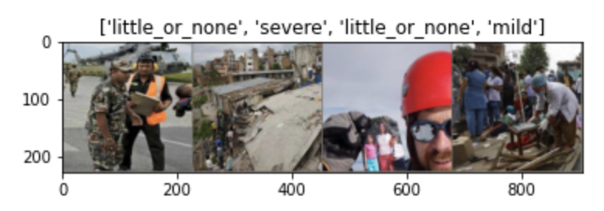
3. Methodology-Data Preprocessing
Custom PyTorch dataset and dataLoader
Shuffle
Data augmentation and normalization for training
Label Encode
PIL Image
Batch Size
Random Resized Crop
Random Horizontal Flip
To Tensor
Normalize
Normalization for validation
Resize
Center Crop
ToTensor
Normalize

Slide 12
3. Methodology-Data Modeling
Criterion
Optimizer
Learning rate
Cross Entropy Loss
Stochastic gradient descent
Momentum
lr_scheduler
Step size
Gamma
Epoch
Inception v3
Transfer learning
Pre-trained networks
Sufficient training datasets
Reasonable architectures
ResNet 50
VGG 16

Slide 13
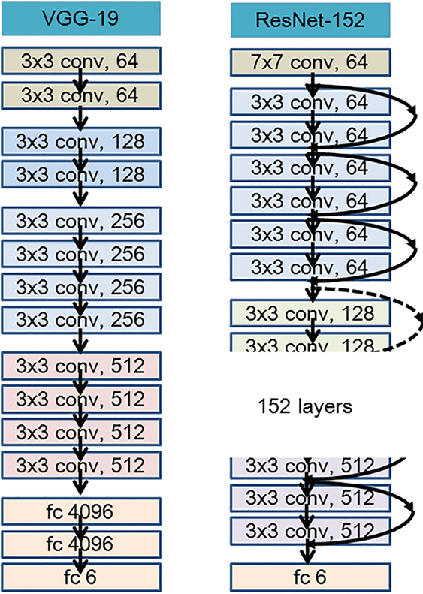
3. Methodology-Mode Visualizations
Residual mapping
Fewer filters
Lower complexity
Shortcut connection
Network
Counterpart residual version
Identity mapping
Extra zero entries padded
Increasing dimensions
No additional parameter
F(x{w}+x)
Match dimensions
1×1 convolutions
Figure from ResearchGate
Notes:
References 9-10

Slide 14
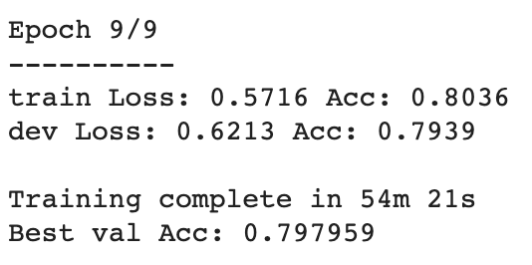
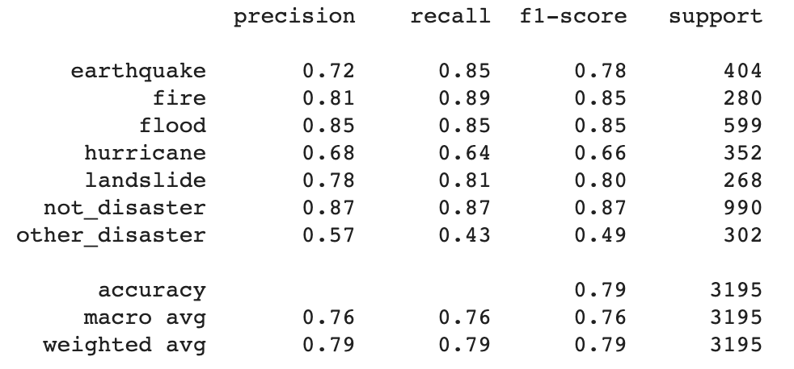
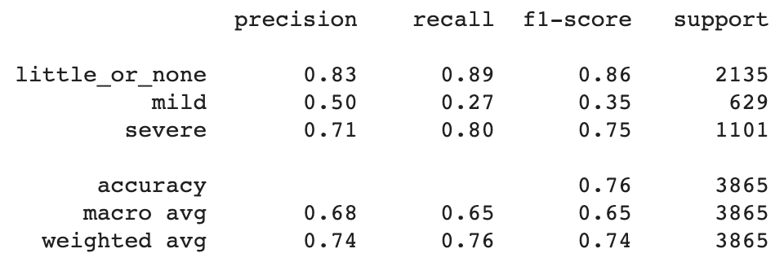
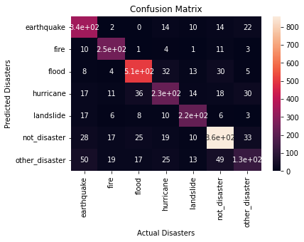
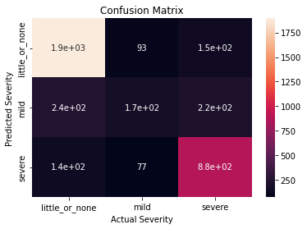
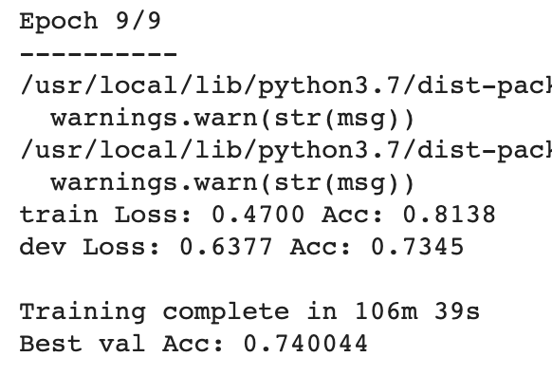
4. Results & Analysis

Slide 15
5. Conclusion
Midterm summary
Following steps
Notes:
Future steps:
Other pre-trained models
Hyperparameter tuning
Imbalanced data

Slide 16
References
What We’re Watching: Weekly Disaster Update, https://disasterphilanthropy.org/blog/other/what-were-watching-weekly-disaster-update/
As Sandy Became #Sandy, Emergency Services Got Social, https://www.fastcompany.com/3002837/sandy-became-sandy-emergency-services-got-social
'Please Send Help.' Hurricane Harvey Victims Turn to Twitter and Facebook, https://time.com/4921961/hurricane-harvey-twitter-facebook-social-media/
Henan floods, https://en.wikipedia.org/wiki/2021_Henan_floods
CrisisMMD: Multimodal Twitter Datasets from Natural Disasters，https://arxiv.org/pdf/1805.00713v1.pdf
Damage Identification in Social Media Posts using Multimodal Deep Learning，http://idl.iscram.org/files/husseinmouzannar/2018/2129_HusseinMouzannar_etal2018.pdf
Analysis of Social Media Data using Multimodal Deep Learning for Disaster Response，https://arxiv.org/pdf/2004.11838v1.pdf
Deep Learning Benchmarks and Datasets for Social Media Image Classification for Disaster Response, https://crisisnlp.qcri.org/crisis-image-datasets-asonam20
Deep neural networks show an equivalent and often superior performance to dermatologists in onychomycosis diagnosis: Automatic construction of onychomycosis datasets by region-based convolutional deep neural network - Scientific Figure on ResearchGate, https://www.researchgate.net/figure/The-representation-of-model-architecture-image-for-ResNet-152-VGG-19-and-two-layered_fig2_322621180
A Review of Popular Deep Learning Architectures: ResNet, InceptionV3, and SqueezeNet, https://blog.paperspace.com/popular-deep-learning-architectures-resnet-inceptionv3-squeezenet/

